Slide 1
Financial Analytics

Slide 2
Introduction
Objective:
This report aims to analyze the financial performance of company/organization over specific period.
Scope:
It covers key financial metrics including [list specific metrics such as revenue, profitability, liquidity ratios, etc.].
Importance:
Understanding these metrics will provide insights into the financial health of [company/organization] and inform strategic decision-making.

Slide 3
Details of Data
Following is the data provided to do analysis on :-
Serial NumberNameName of CompanyMar Cap – CroreMarket Capitalization in
CroresSales Qtr – CroreQuarterly Sale in crores.

Slide 4
Main KPIs
Market Capitalization (Mar Cap)
Quarterly Sales (Sales Qtr)
Market Cap to Sales Ratio

Slide 5
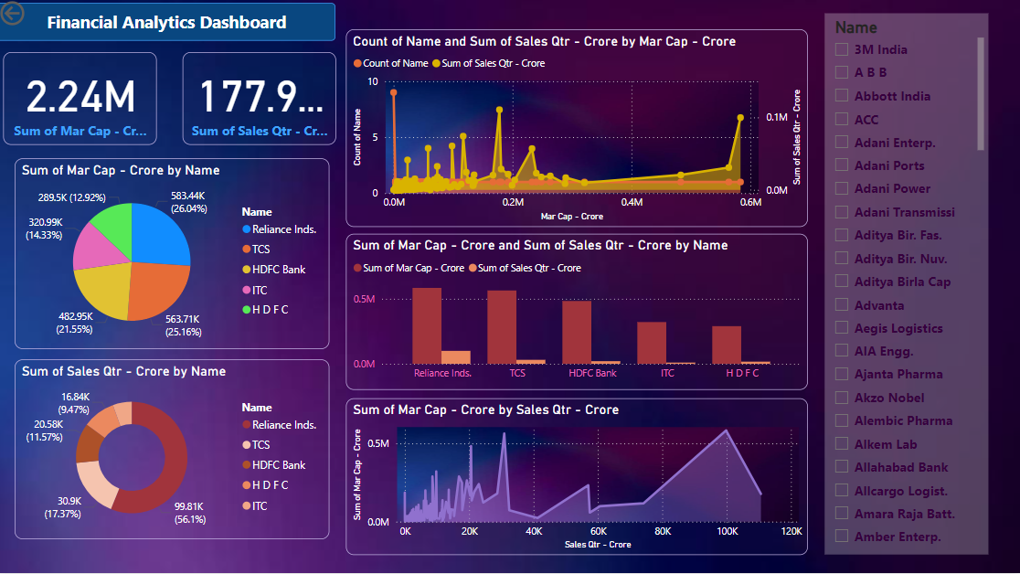
My Design

Slide 6
Thank You

